Slide 1
Module 5 Part 3
The Business Case
Project Charter
Project Planning
Project Scope

Slide 2
An Information Technology Project Methodology
A methodology provides a strategic-level plan for managing and controlling IT projects.
Think of a methodology as a template for initiating, planning, and developing an information system.
Although information systems may be different, it is the product, and not necessarily the process, of managing the project that makes them different.
The methodology recommends the phases, deliverables, processes, tools, and knowledge areas for supporting an IT project.

Slide 3
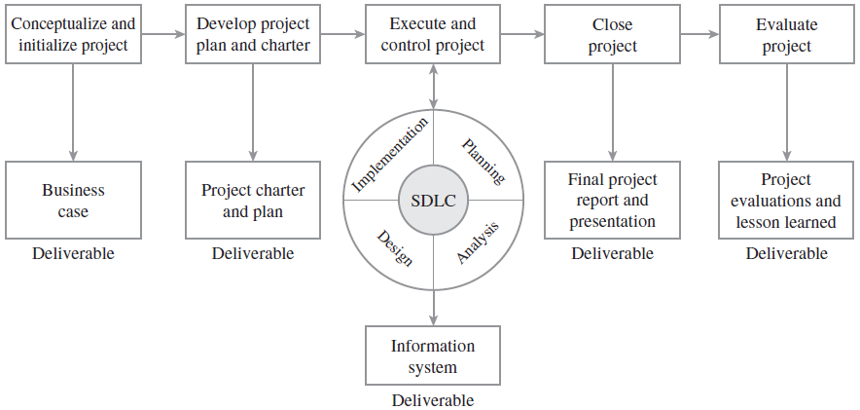
An Information Technology Project Methodology

Slide 4
The Business Case
Page 42 to 57, Information technology project management 4th Edition, Jack T. Marchewka

Slide 5
The Business Case
A business case provides the first deliverable in the IT project life cycle.
It provides an analysis of the organizational value, feasibility, costs, benefits, and risks of several proposed alternatives or options.
A business case is not a budget or the project plan.
The purpose of a business case is to provide senior management with all the information needed to make an informed decision as to whether a specific project should be funded (Schmidt 1999a).

Slide 6
The Business Case
For larger projects, a business case may be a large, formal document.
Even for smaller projects, however, the process of thinking through why a particular project is being taken on and how it might bring value to an organization is still useful.
Because assumptions and new information are sometimes used to make subjective judgments, a business case must also document the methods and rationale used for quantifying the costs and benefits.
Different people who work independently to develop a business case can use the same information, tools, and methods, but still come up with different recommendations. Therefore, it is imperative that decision makers who read the business case know and understand how it was developed and how various alternatives were evaluated.

Slide 7
The Business Case
One can also think of a business case as an investment proposal or a legal case.
Like an attorney, the business case developer has a large degree of latitude to structure arguments, select or ignore evidence, and deliver the final presentation.
The outcome depends largely on the ability to use compelling facts and logic in order to influence an individual or group with decision-making authority.
Thus, a good IT business case should be
thorough in detailing all possible impacts, costs, and benefits;
clear and logical in comparing the cost/benefit impact of each alternative;
objective through including all pertinent information; and
systematic in terms of summarizing the findings.

Slide 8
Developing the Business Case
The purpose of a business case is to show how an IT solution can create business value. Although IT projects can be undertaken for any number of reasons, organizational value generally focuses on improving effectiveness and/or efficiency.
For example, an IT project may be undertaken to:
Reduce costs
Create a new product or service
Improve customer service
Improve communication
Improve decision making
Create or strengthen relationships with suppliers, customers, or partners
Improve processes
Improve reporting capabilities
Support new legal requirements
The business case must show explicitly how an investment in IT will lead to an increase in business value.

Slide 9
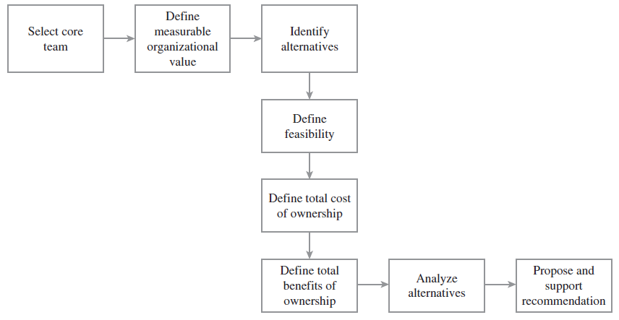
The Process for Developing a Business Case

Slide 10
Step 1: Select the Core Team
Rather than have one person take sole responsibility for developing the business case, a core team should be recruited.
If possible, developing a business case should include many of the stakeholders affected by the project or involved in its delivery.
The core team should, therefore, include managers, business specialists, and users who understand the requirements to be met, as well as IT specialists who understand the opportunities, limitations, and risks associated with IT.

Slide 11
Step 2. Define Measurable Organizational Value (MOV)
The core team’s objective should be to define the problem or opportunity and then identify several alternatives that will provide direct and measurable value to the organization.
To provide real value to an organization, however, IT projects must align with and support the organization’s goals, mission, and objectives.
Therefore, any recommended alternative by the core team must have a clearly defined purpose and must map to the goals and strategy of the organization.
The goal of the project then becomes the project’s measure of success.
In the IT project management methodology, the project’s overall goal and measure of success is referred to as the project’s measurable organizational value (MOV).

Slide 12
Step 3: Identify Alternatives
Since no single solution generally exists for most organizational problems, it is imperative to identify several alternatives before dealing directly with a given business opportunity.
The alternatives, or options, identified in the business case should be strategies for achieving the MOV.
It is also important that the alternatives listed include a wide range of potential solutions as well as a base case alternative that describes how the organization would perform if it maintained the status quo—that is, if it did not pursue any of the options described in the business case. In some situations, maintaining the status quo may be the best alternative.
It is important to be open to and objective on all viable options.

Slide 13
Step 3: Identify Alternatives
The base case should also delve into the realistic costs of maintaining the current system over time.
Include such things as increased maintenance costs of hardware and software, as well as the possibility for more frequent system failures and downtime.
However, if the demand for service decreases, maintaining a legacy system may be a more viable alternative than a proposed new system.

Slide 14
Step 4: Define Feasibility and Assess Risk
Each option or alternative must be analyzed in terms of its feasibility and potential risk.
Feasibility should focus on whether a particular alternative is doable and worth doing.
Risk, on the other hand, focuses on what can go wrong and what must go right.
Analyzing the feasibility and risk of each alternative at this point may act as a screening process for ruling out any alternatives that are not worth pursuing.

Slide 15
Step 4: Define Feasibility and Assess Risk
Feasibility may be viewed in terms of:
Economic feasibility
Technical feasibility
Organizational feasibility
Other feasibilities
such as legal and ethical feasibility etc.
Risk should focus on:
Identification—What can go wrong? What must go right?
Assessment—What is the impact of each risk?
Response—How can the organization avoid or minimize the risk?

Slide 16
Step 5: Define Total Cost of Ownership
The decision to invest in an IT project must take into account all of the costs associated with the application system.
Total Cost of Ownership (TCO) is a concept that has gained widespread attention and generally refers to the total cost of acquiring, developing, maintaining, and supporting the application system over its useful life.
TCO includes such costs as:
Direct or up-front costs—Initial purchase price of all hardware, software, and telecommunications equipment, all development or installation costs, outside consultant fees, etc.
Ongoing costs—Salaries, training, upgrades, supplies, maintenance, etc.
Indirect costs—Initial loss of productivity, time lost by users when the system is down, the cost of auditing equipment (i.e., finding out who has what and where), quality assurance, and post-implementation reviews

Slide 17
Step 6: Define Total Benefits of Ownership
The Total Benefits of Ownership (TBO) must include all of the direct, ongoing, and indirect benefits associated with each proposed alternative.
The TBO should address the benefits of an alternative over the course of its useful life.
Benefits can arise from:
Increasing high-value work—For example, a salesperson may spend less time on paperwork and more time calling on customers
Improving accuracy and efficiency—For example, reducing errors, duplication, or the number of steps in a process
Improving decision making—For example, providing timely and accurate information
Improving customer service—For example, new products or services, faster or more reliable service, convenience, and so on

Slide 18
Step 7: Analyze Alternatives
Once costs and benefits have been identified, it is important that all alternatives be compared with each other consistently.
Understanding the financial and numeric tools and techniques required by financial people and senior management is critical, even for the technically savvy.
Being able to communicate effectively using their terms and tools increases one’s credibility and the chances of getting projects approved and funded.
There are several ways to analyze the proposed alternatives. The most common are
financial models
scoring models

Slide 19
Step 8: Propose and Support the Recommendation
Once the alternatives have been identified and analyzed, the last step is to recommend one of the options.
It is important to remember that a proposed recommendation must be supported.
If the analysis was done diligently, this recommendation should be a relatively easy task.
The business case should be formalized in a professional-looking report.
Remember that the quality and accuracy of your work will be a reflection on you and your organization.
A potential client or project sponsor may not give you a second chance.

Slide 20
Project Charter
Page 85 to 89, Information technology project management 4th Edition, Jack T. Marchewka

Slide 21
Project Charter
The project charter and baseline project plan provide a project governance framework for carrying out or executing the IT project.
More specifically, the project charter serves as an agreement or contract between the project sponsor and project team—documenting the project’s MOV, defining its infrastructure, summarizing the project plan details, defining roles and responsibilities, showing project commitments, and explaining project control mechanisms.

Slide 22
What Should Be in a Project Charter?
The framework for a project charter should be based on the project management knowledge areas.
Although the formality and depth of developing a project charter will most likely depend on the size and complexity of the project, the fundamental project management and product-development processes and areas should be addressed and included for all projects.
Organizations and project managers should adapt the project charter based on best practices, experience, and the project itself.

Slide 23
Project Charter Template
Project Name or Identification
Project Stakeholders
Names
Titles or roles
Phone numbers
Email addresses
Project Description
Background
Description of the challenge or opportunity
Overview of the desired impact
Measurable Organizational Value (MOV)
Statement or table format

Slide 24
Project Charter Template (Contd.)
Project Scope
What will be included in the scope of this project
What will be considered outside the scope of this project
Project Schedule Summary
Project start date
Project end date
Timeline of project phases and milestones
Project reviews and review dates
Project Budget Summary
Total project budget
Budget broken down by phase
Quality Issues
Specific quality requirements

Slide 25
Project Charter Template (Contd.)
Resources Required
People
Technology
Facilities
Other Resources to be provided
Resource
Name of resource provider
Date to be provided
Assumptions and Risks
Assumptions used to develop estimates
Key risks, probability of occurrence, and impact
Constraints
Dependencies on other projects or areas within or outside the organization
Assessment project’s impact on the organization
Outstanding issues

Slide 26
Project Charter Template (Contd.)
Project Administration
Communications plan
Scope management plan
Quality management plan
Change management plan
Human resources plan
Implementation and project closure plan
Acceptance and Approval
Names, signatures, and dates for approval
References
Terminology or Glossary
Appendices (as required)

Slide 27
Project Planning
Page 91 to 93, Information technology project management 4th Edition, Jack T. Marchewka

Slide 28
Project Planning
A project plan attempts to answer the following questions:
What needs to be done?
Who will do the work?
When will they do the work?
How long will it take?
How much will it cost?

Slide 29
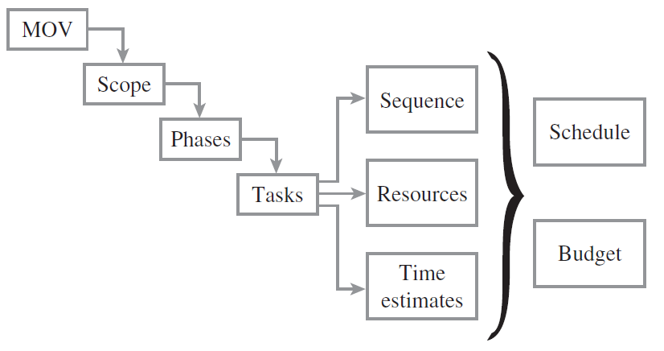
The Project Planning Framework

Slide 30
The MOV
The project’s measurable organizational value, or MOV must be defined and agreed on before proceeding to the other steps of the project planning framework.
The project’s MOV provides a direct link to the organization’s strategic mission.
Project’s MOV acts as a bridge between the strategic mission and objectives of the organization and the project plans of individual projects it undertakes.
The MOV guides many of the decisions related to scope, schedule, budget, and resources throughout the project’s life cycle.

Slide 31
Define the Project’s Scope
Once the project’s MOV has been defined and agreed upon, the organization must make a commitment, in terms of time and resources, to define the project’s scope in order to estimate the project’s schedule and budget.
Scope includes the products or services to be provided by the project and includes all of the project deliverables.
One can think of scope as the work that needs to be completed in order to achieve the project’s MOV.

Slide 32
Define the Project’s Scope
Project scope management includes:
Planning
The project team must develop a detailed scope statement that defines the work to be included, as well as the work not to be included in the project plan.
The scope statement will be used to guide future project-related decisions and to set stakeholder expectations.
Definition
The project’s scope must be organized into smaller and more manageable packages of work.
These work packages will require resources and time to complete.
This may include more detail than the preliminary scope statement in the project charter.
Verification
Once the project’s scope has been defined, the project team and stakeholders must verify it to ensure that the work completed will in fact support the project in achieving its MOV.
Change Control
Controls must be in place to manage proposed changes to the project’s scope.
Scope changes can either move the project closer to its MOV or result in increased work that drains the project’s budget and causes the project to exceed its scheduled deadline.
Proper scope control procedures can ensure that the project stays on track.

Slide 33
Subdivide the Project into Phases
Once the project’s scope has been defined and verified, the work of the project can be organized into phases and subphases in order to complete all of the project’s deliverables.
Phases are logical stages that organize the project work to reduce complexity and risk.
In many cases, it is easier to focus and concentrate the project team’s effort on the pieces instead of the whole; however, it is important to keep an eye on the big picture.
Each phase of the project should focus on providing at least one specific project deliverable—that is, a tangible and verifiable piece of work.

Slide 34
Tasks—Sequence, Resources, and Time Estimates
Once the project is divided into phases, tasks are then identified.
A task may be thought of as a specific activity or unit of work to be completed.
Examples of some tasks in an IT project may be to interview a particular user, write a program, or test links in a Web page.
When considering tasks, it is important to consider sequences, resources, and time.

Slide 35
Sequence
Some tasks may be linear—that is, have to be completed in a particular sequence— while others can be completed in parallel—that is at the same time.
Performing parallel tasks often provides an opportunity to shorten the overall length of the project.
For example,
assume that a project has two tasks—A and B.
Task A will require only one day to complete;
task B requires two days.
If these tasks are completed one after the other, the project will finish in three days.
On the other hand, if these tasks are performed in parallel, the length of the project will be two days. In this case, the length of the project is determined by the time it takes to complete the longest task (i.e., task B).
This simple example illustrates two important points:
A project is constrained by the longest tasks, and
Any opportunity to perform tasks in parallel can shorten the project schedule.

Slide 36
Resources
Resources on an IT project may include such things as technology, facilities (e.g., meeting rooms), and people.
Tasks require resources, and there is a cost associated with using a resource.
The use of a resource may be accounted for by using a per-use charge or on a prorated basis—that is, a charge for the time you use that resource.
For example, a developer earns $50,000 a year and is assigned to work on a task that takes one day to complete. The cost of completing that particular task would be prorated as $191 (assuming an eight-hour, five-day work week).

Slide 37
Time
It will take a resource a specific amount of time to complete a task.
The longer it takes a resource to complete a specific task, however, the longer the project will take to finish and the more it will cost.
For example, if we plan on assigning our developer who earns $50,000 a year to a task that takes two days, then we would estimate the cost of completing that task to be approximately $400.
If the developer completes the task in one-half the time, then the cost of doing that task will be about $200.
Moreover, if the developer were then free to start the next task, our schedule would then be ahead by one day.
Unfortunately, the reverse is true. If we thought the task would take two days to complete (at a cost of $400) and it took the developer three days to complete, the project would be one day behind schedule and $200 over budget.

Slide 38
Relationship in Tasks, Resources and time
If two tasks could be performed in parallel, with our developer working on Task A (one day) and another $50,000/year-developer working on Task B (two days), then even if Task A takes two days, our project schedule would not be impacted—as long as the developer working on Task B completes the task within the estimated two days. While this parallel work may save our schedule, our budget will still be $200 over budget because task A took twice as long to complete.
Understanding this relationship among tasks, resources, and time will be important when developing the project plan and even more important later if it is necessary to adjust the project plan in order to meet schedule or budget constraints.

Slide 39
Schedule and Budget
The detailed project plan is an output of the project planning framework.
Once the tasks are identified and their sequence, resources required, and time to complete estimated, it is a relatively simple step to determine the project’s schedule and budget.
All of this information can be entered into a project management software package that can determine the start and end dates for the project, as well as the final cost.
Once completed, the project plan should be reviewed by the project manager, the project sponsor, and the project team to make sure it is complete, accurate, and, most important, able to achieve the project’s MOV.
Generally, the project plan will go through several iterations as new information becomes known or if there are compromises with respect to scope, schedule, and budget.
In addition, many of the details of the project plan are summarized in the project charter in order to provide a clearer picture as to how the plan will be carried out.

Slide 40
The Baseline Plan
Once the project plan is approved, it becomes the baseline plan that will serve as a benchmark to measure and gauge the project’s progress.
The project manager will use this baseline plan to compare the actual schedule to the estimated schedule and the actual costs to budgeted costs.

Slide 41
Project Scope
Page 135 to 148, Information technology project management 4th Edition, Jack T. Marchewka

Slide 42
Project Scope
To be Added
Page 135 to 148, Information technology project management 4th Edition, Jack T. Marchewka

Slide 43
End

